Slide 1
The Pitch Deck
A pitch deck is a short summary of your idea and is the main method to raise interest by investors, venture capital (VC) fonds and business angels and thus instrumental in attracting funding
A pitch deck should
Introduce a clear need
Highlight why the need is currently not met
Suggest a new way of meeting this need
Path out a way to actually servicing this need in the market
The following pitch deck introduces the (obviously artificial) product DCalculator – a numerical calculator powered by a solar cell (you should come up with a better idea obviously ☺)

Slide 2
What is the Problem? Calculations everywhere!
Numerical calculations are omnipresent in life and we have to do dozens of calculations per day.
However, we are often relying on our smartphones which constantly run out of battery thus leaving us unable to perform the calculations. Why?
Because the smartphone is small and compact and can do very complex calculations. However, the smartphone is a phone and not a calculator → not optimized for this purpose.
[introduction to the solution: Why should we care about the problem? How are we currently addressing the probe?]
Customer Need
&
Quick Calculations
Complex calulations
Ultrahigh precision
Everywhere
At any location
Without a battery

Slide 3
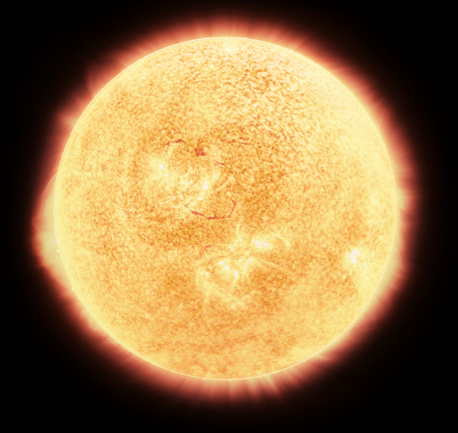
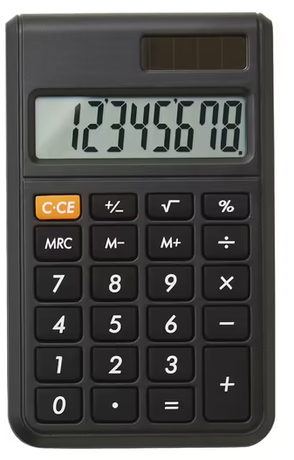
The Solution: power of the sun and the machine
The Solution:
A highly optimized calculator fueled by the power of the sun
Highest mathematical precision
Ultrafast results
Fueled by the power of the sun → available anywhere on the planted
[put down the advantages of your solution here]
Patented technology
Orders of magnitude cheaper than a phone
No energy supply required, no battery necessary
100 % recyclable, almost unlimited lifetie
[put down your Unique Selling Points (USPs) → what distinguishes your solution from all the rest the market has to offt]
Our first prototype

Slide 4
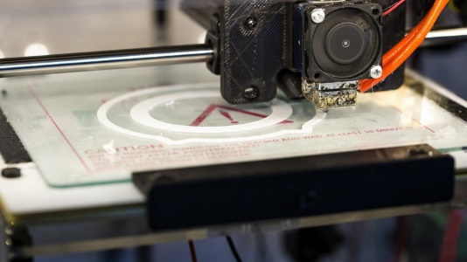
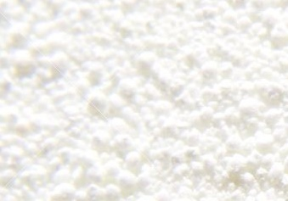
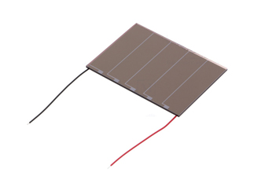
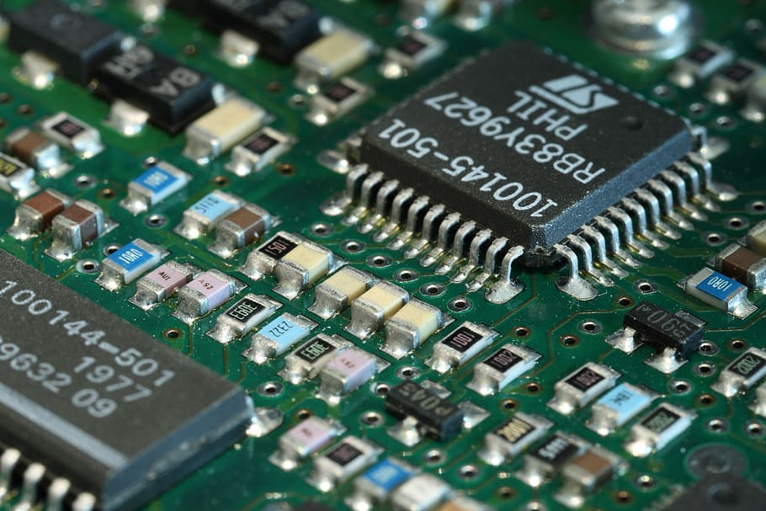
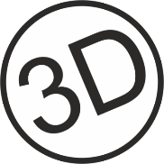
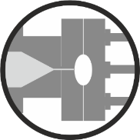
The DCalculator: How to reach the customer
3D printing of case (2 €)
Raw materials
Solar cell (3 €)
Mail-order circuit board (4 €)
DCalculator
Scalable manufacturing
Can be manufactured (on a community basis) via 3D printing
Can be manufactured by cost-effective technology like injection molding
Cost-to-market
Can be manufacture for less than 10 €
Lean manufacturing concept based on 3D printing and mail-order circuit board

Slide 5
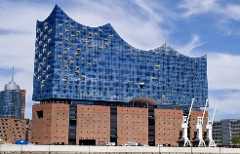
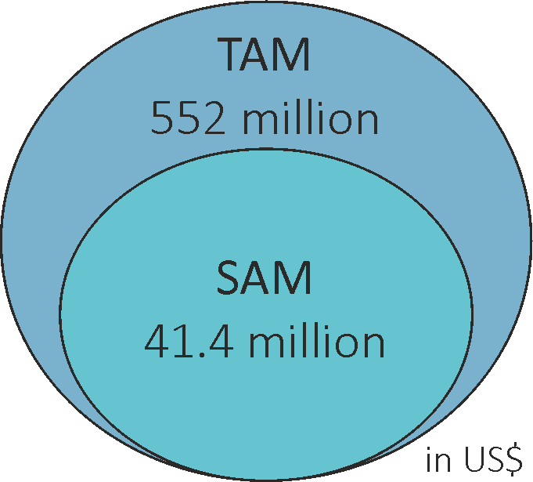
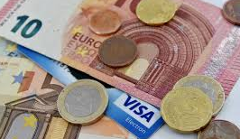
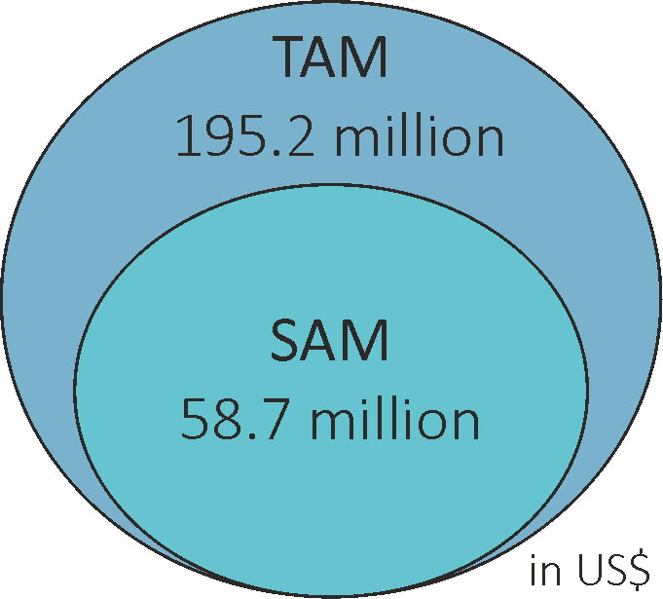
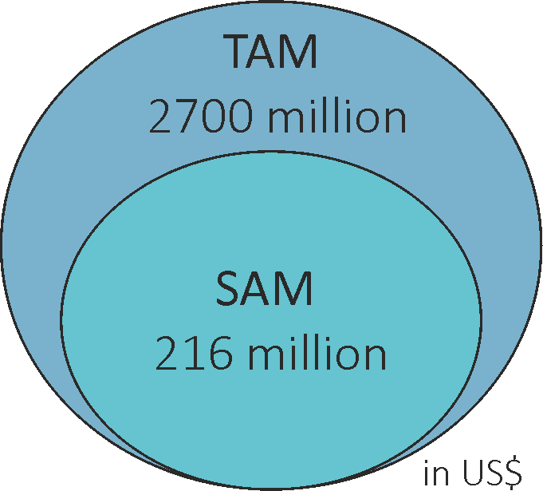
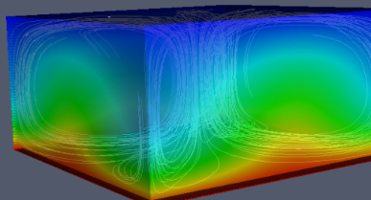
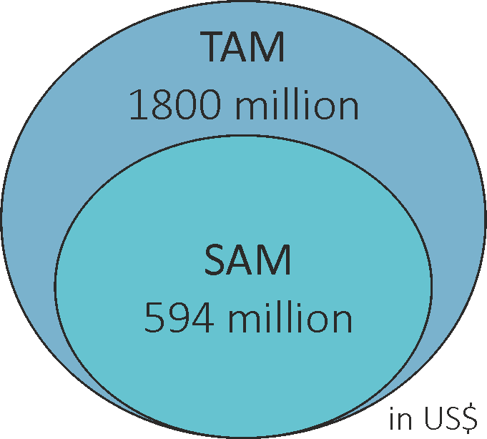
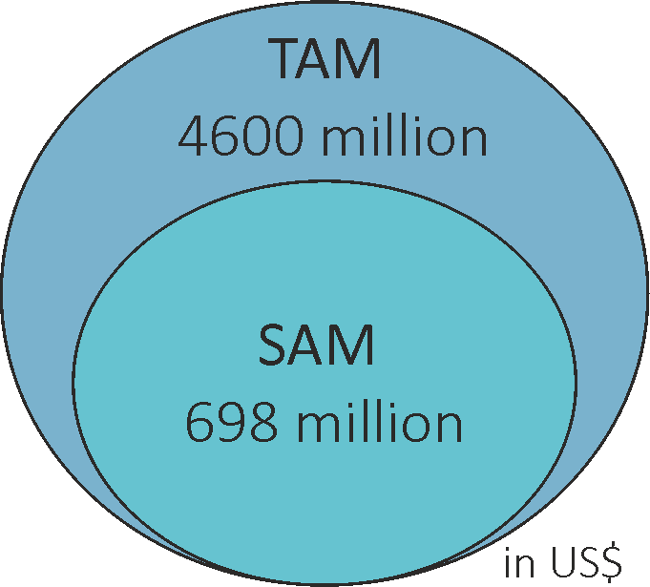
Major Potential in various Target Markets
[do a quick market analysis using, e.g., MarketsAndMarkets and evaluate the potential market size for you solution, name about 3 – 5 potential markets; TAM = total available market (how big is the market overall), SAM = servicable available market (how big is the market segment you would be able to reach)]
Architecture
Calculation on site
Finance
Precision calculation required
Wheather
Forecasts require precision
Numerics
It’s in the name!
Cryptography
Keeping data safe
will transform the way we calculate in the 21st century
[What would your solution offer as an advanteg in these markets?]
Improved calculation precision
Improved energy efficiency
Improved sustainable
Improved image quality
[What is the current competition in the respective markets]
Competition
Excel, Computers, Abacus
Frogs
Computers
Token generators
[Why is your solution a good addition to the market]
Calculation precision: unmatched precision
In a sustainable device: using sunlight as sole energy source
is
unique, combining:
1
2
TAM: totac accessible market SAM: servicable accessible market

Slide 6
The Team and our Way Forward
[present your team – who are you? Why are you qualified for achieving this? What does each of you bring to the table? This helps build credibility at the early stage where you may not have a lot of data to show]
Team leader
G. Goofy
Integrator, team leader, expert science communicator
What are the next steps?
[How will you make your idea a reality? What would the Pfiffikus allow you to do? Which next steps will you tackle?]
Scientific expert
D. Düsentrieb
Decades of experience in development and research
Finances
D. Duck
Absolute expert in financing; really good in talking to investors

